Slide 1

REACT Js

Slide 2
Introduction
React is a declarative, efficient, and flexible JavaScript library for building user interfaces. It lets you compose complex UIs from small and isolated pieces of code called “components”.
Developed by Facebook
React is a view layer library, not a framework like Backbone, Angular etc.

Slide 3
Prerequisites
HTML
CSS
JAVASCRIPT
ES6

Slide 4
WHY REACT
Complexity of two-way data binding
Bad UX from using "cascading updates" of DOM tree
A lot of data on a page changing over time

Slide 5
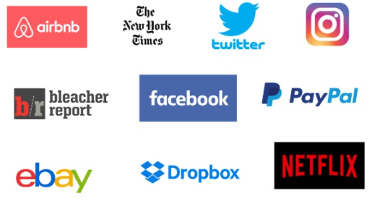
Who uses React?

Slide 6
Installation
npx create-react-app app-name
cd app-name
To start server->npm start

Slide 7
REACT JS Fundamentals
Components
Props
State
JSX
Virtual Dom

Slide 8
Components
Components are self-contained reusable building blocks of web application.
Components let you split the UI into independent, reusable pieces, and think about each piece in isolation
Two types of Components : Function and Class Components

Slide 9
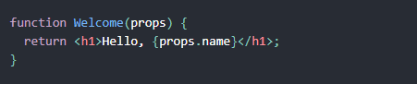
Functional Components

Slide 10
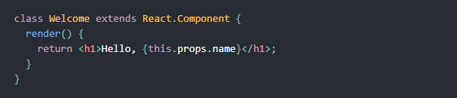
Class Components

Slide 11
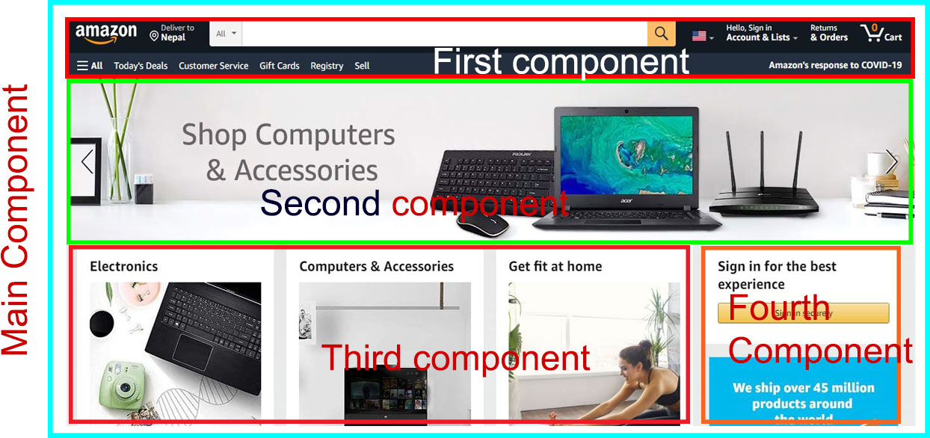
Components architecture

Slide 12
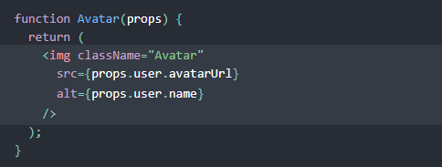
PROPS
Passed down to component from parent component and represents data for the component

Slide 13
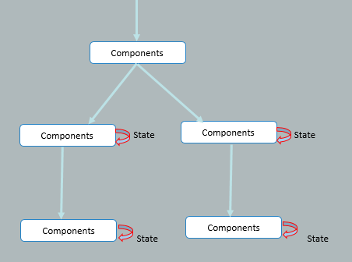
State
Heart of React Components
Must be Kept as simple as possible
Determines components rendering and behavior
Creates dynamic and interactive components

Slide 14
JSX
XML-like syntax for generating component's HTML
Easier to read and understand large DOM trees

Slide 15
Virtual dom
The virtual DOM is used for efficient re-rendering of the DOM
React aims to re-render the virtual tree only when the state changes
Whenever possible, does not update entire component in real DOM - only computes a patch operation that updates part of the DOM

Slide 16
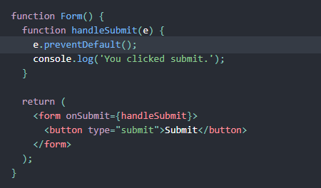

Handling Events

Slide 17
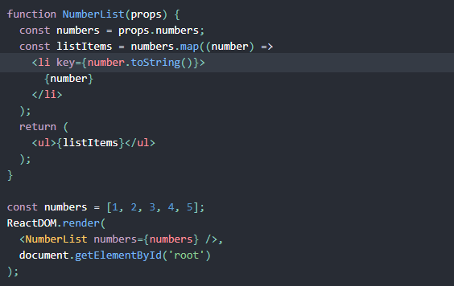
List and Keys
Keys are the elements which helps Reacts to identify components uniquely

Slide 18
Hooks
Hooks are a new addition in React 16.8. They let you use state and other React features without writing a class.
State Hook
Effect Hook

Slide 19
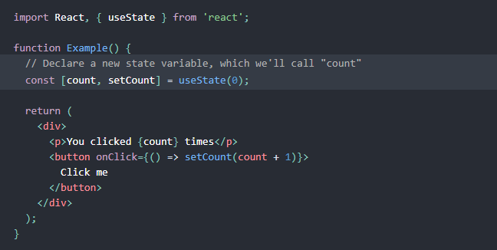
State Hook
useState is a new way to use the exact same capabilities that this.state provides in class. Normally, variables “disappear” when the function exits but state variables are preserved by React.

Slide 20
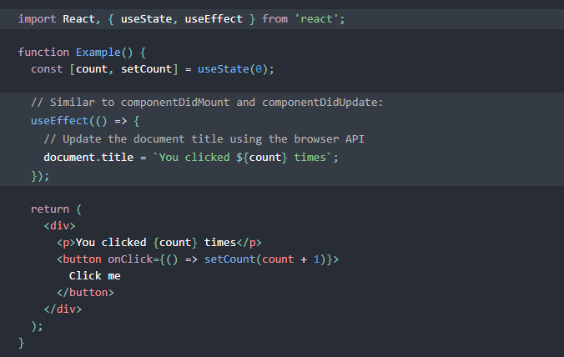
Effect Hook
The Effect Hook lets you perform side effects in function components
Data fetching, setting up a subscription, and manually changing the DOM in React components are all examples of side effects.

Slide 21
React Router
React Router is powerful routing library built on top of React Framework
It helps in adding new screens and flows to the application very quickly
It keeps the URL in Sync with the data that’s being displayed on the web page

Slide 22
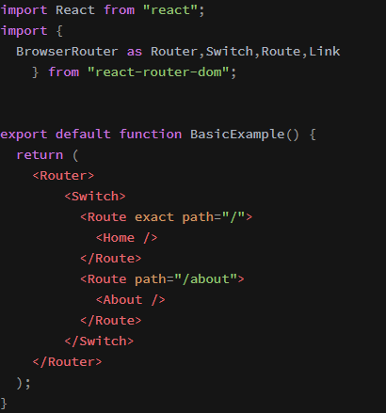
React Router Installation
npm install react-router-dom

Slide 23
Form Validation
We use Formik and Yup for form validation in React
npm install formik
npm install yup

